Slide 1
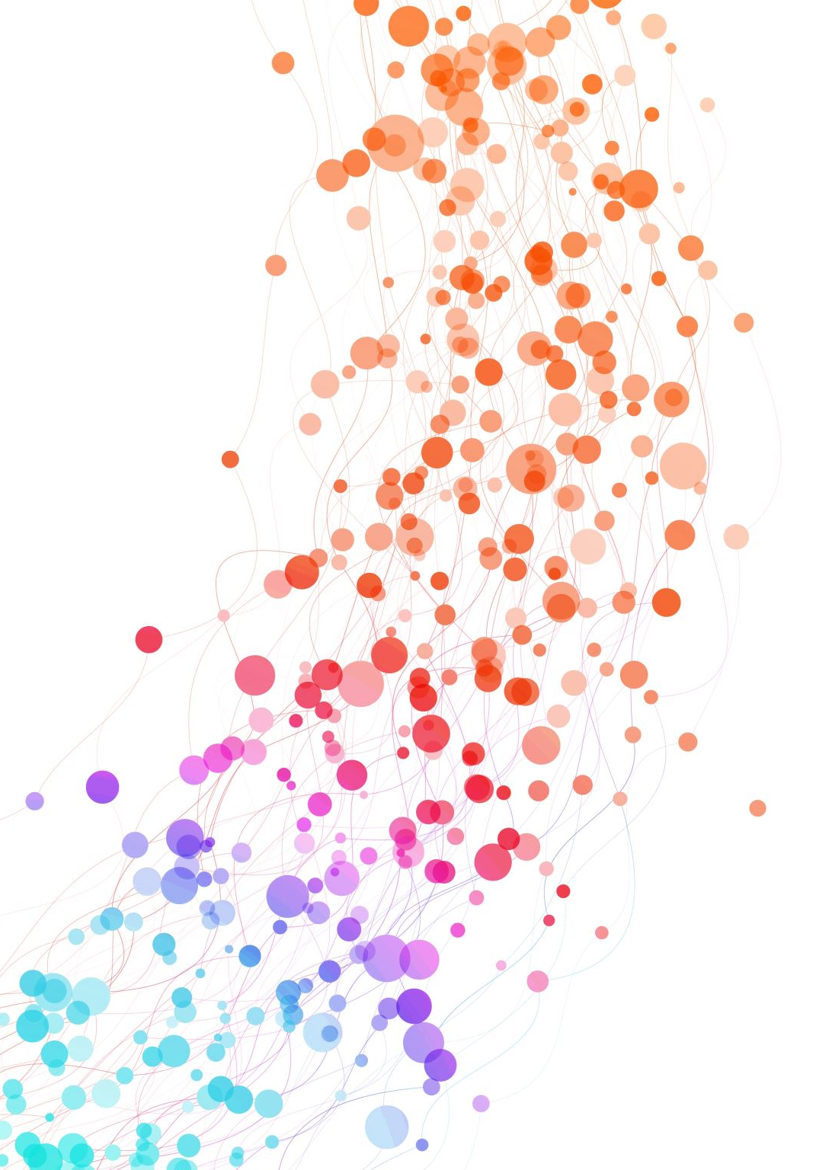
NYPD Shooting Incident Data (Historic:2006-2023)
By Teja Lakshmi Gangadhar Chalumuri
GitHub Cs668
Professor : Dr. Christelle Scharff

Slide 2
Introduction
Increase in Gun Violence :. NYC has seen a rapid escalation in gun violence, especially in urban neighborhoods with high population densities.
Link to Socioeconomic Conditions: Understanding the root causes, Such as income disparity and community characteristics, is essential for effective interventions.
Critical Need for Spatial and Temporal Analysis : Analyzing where and when incidents occur can help target the most affected areas.

Slide 3
Research Questions
Exploring Gun Violence Patterns and Impacts
Trends Over Time : How has gun violence fluctuated annually, seasonally and by neighborhood in NYC?
Demographics and Risk Factors: Which neighborhoods and demographics are most affected by gun violence?
Temporal Patterns and Locations: Are there particular times and places where shootings are more likely to occur?

Slide 4
Literature Review
Urban gun violence tends to stress the importance of space-time analysis in mapping the underlying patterning of crime, While the identified hotspots were done using GIS and spatial data mining, limitations relate to not having real-time accuracy and comprehensive socio-economic integration of matched data.
Research also highlights cultural and policy factors, with some evidence suggesting that changes in gun policies do not entirely explain the behaviors of local violence.
Community health effects show that being exposed to violence has a discouraging effect on family structures around a neighborhood.
All these literature generally point to multidimensional approaches, where socio-economic and demographic data are essential in laying effective strategies for preventing violence.

Slide 5
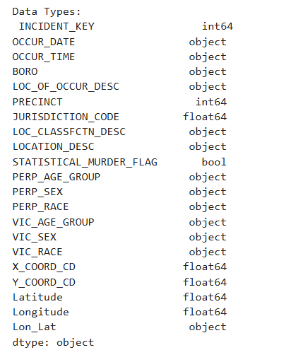
Dataset
Data Link: NYC Open Data
Description: Contains shooting incidents from 2006 to 2023 across NYC.
Size: Over 20,000 records with various incident details. The dataset contains of 5 rows × 21 columns.
Key Variables: Date, borough, location type, victim and perpetrator demographics.
Snapshot:

Slide 6
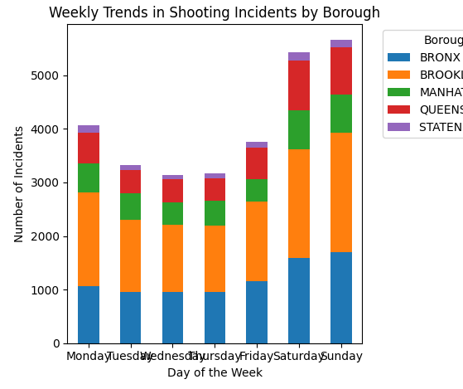
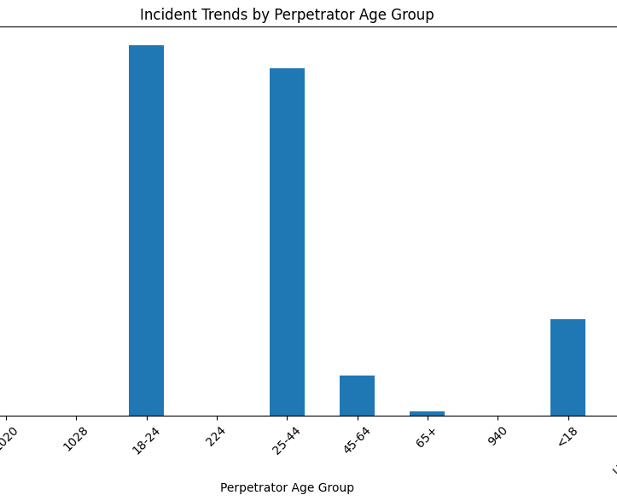
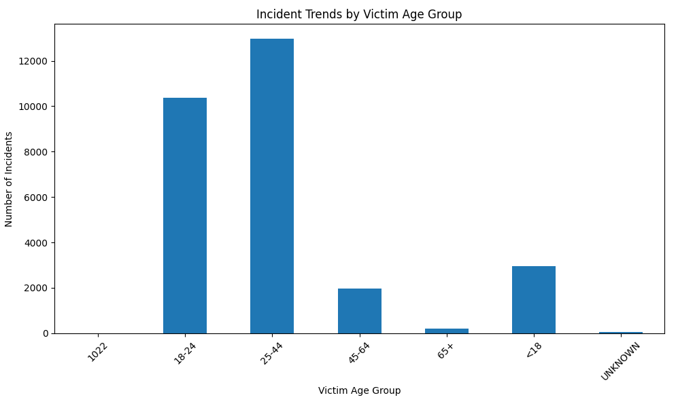
EDA & Methodology
Chart 1: Weekly Trends in Shooting Incidents by Borough
Observations:
Saturday and Sunday have the highest number of incidents across boroughs, indicating a possible increase in incidents on weekends.
Brooklyn and The Bronx consistently report higher numbers across all days, especially on weekends.
Staten Island shows the lowest incident counts each day..
Chart 2: Incident Trends by Victim Age Group
Observations:
The 25-44 age group has the highest number of victims, followed closely by the 18-24 age group.
Under 18 and 45-64 age groups have significantly fewer incidents.
The 65+ group has the least number of incidents.
Key Insights
Age Group Patterns: Victims and suspects are mostly concentrated in the 18-44 age bracket, indicating that young adult's figure more disproportionately in these incidents as victims and perpetrators.
Weekday Trends: This weekend surge, especially in Brooklyn and The Bronx, might imply heightened risk during these times and may be indicative of targeted intervention..
Methodology:
Trend analysis by year, month, and day.
Spatial distribution by borough and location type.
Demographic analysis focusing on age and gender of victims and perpetrators.

Slide 7
Next Steps
Further Analysis: Incorporate Socioeconomic Data for Richer Context
Income, jobs, education, and stability in housing are all socioeconomic information that will give meaning to trends or patterns of gun violence.
Predictive Modeling:
Predictive modeling can help identify specific neighborhoods and times of day or year when the risk for shootings is elevated. In this way, analysis may trigger proactive intervention by law enforcement and community groups to effectively deploy resources at high-risk times and locations.
Policy Implications:
Based on such findings, policies could be recommended to handle the root causes and reduce the risk factors.

Slide 8
reference
Patterns of Urban Violent Injury: A Spatio-Temporal Analysis, Authors: Michael Cusimano ,Sean Marshall, Claus Rinner, Depeng Jiang, Mary Chipman https://doi.org/10.1371/journal.pone.0008669
Dataset: Emergency Medical Services and census data.
The Impact of COVID-19 on the Spatial Distribution of Shooting Violence in Buffalo, NY, Authors: Gregory Drake, Andrew Wheeler, Dae-Young Kim, Scott W. Phillips, Kathryn Mendolera. https://www.researchgate.net/publication/354301277_The_impact_of_COVID-19_on_the_spatial_distribution_of_shooting_violence_in_Buffalo_NY
Dataset: The analysis uses a 10-year sample of geocoded shooting data (2010-June 2021) from the Buffalo Police Department, covering 2,481 shooting incidents.
A Statistical Analysis of the Impact of Gun Ownership on Mass Shootings in the USA Between 2013 and 2022. Authors: Madison Daraklis, Mehul Pol, Lindsey Johnson, Cianna Salvatora, Lucy Kerns.https://www.researchgate.net/publication/381152347_A_Statistical_Analysis_of_the_Impact_of_Gun_Ownership_on_Mass_Shootings_in_the_USA_Between_2013_and_2022
Dataset: Data was collected from the Gun Violence Archive (GVA), supplemented by suicide data from the CDC, and socio-economic data from the US Census Bureau.

